Slide 1
TYPES OF TAGS
S.AAYSHA
21CDFE002
II.B.SC COSTUME DESIGN AND FASHION

Slide 2
<!DOCTYPE>
Defines the document type.
All HTML documents must start with a <!DOCTYPE> declaration.
The declaration is not an HTML tag. It is an "information" to the browser about what document type to expect.

Slide 3
<a>
Defines a hyperlink
The <a> tag defines a hyperlink, which is used to link from one page to another.
The most important attribute of the <a> element is the href attribute, which indicates the link's destination.
By default, links will appear as follows in all browsers:
An unvisited link is underlined and blue
A visited link is underlined and purple
An active link is underlined and red

Slide 4
<body>
Defines the document's body
The <body> tag defines the document's body.
The <body> element contains all the contents of an HTML document, such as headings, paragraphs, images, hyperlinks, tables, lists, etc.

Slide 5
<br>
Defines a single line break
The <br> tag inserts a single line break.
The <br> tag is useful for writing addresses or poems.
The <br> tag is an empty tag which means that it has no end tag.

Slide 6
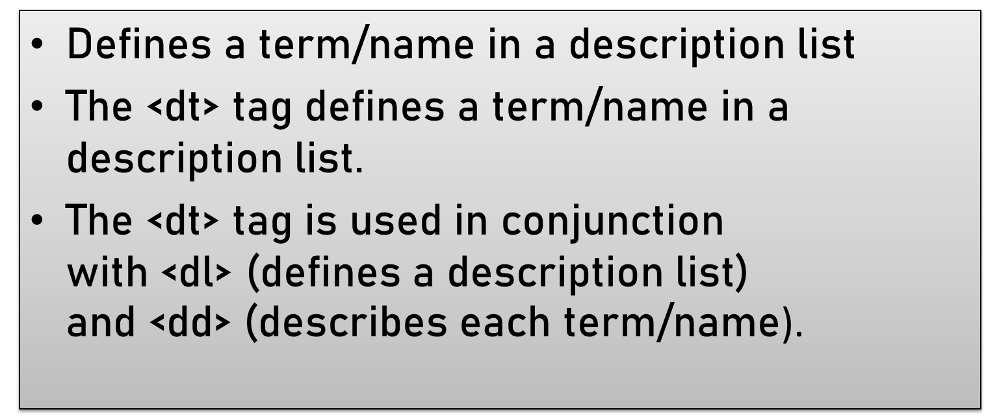
<dt>

Slide 7
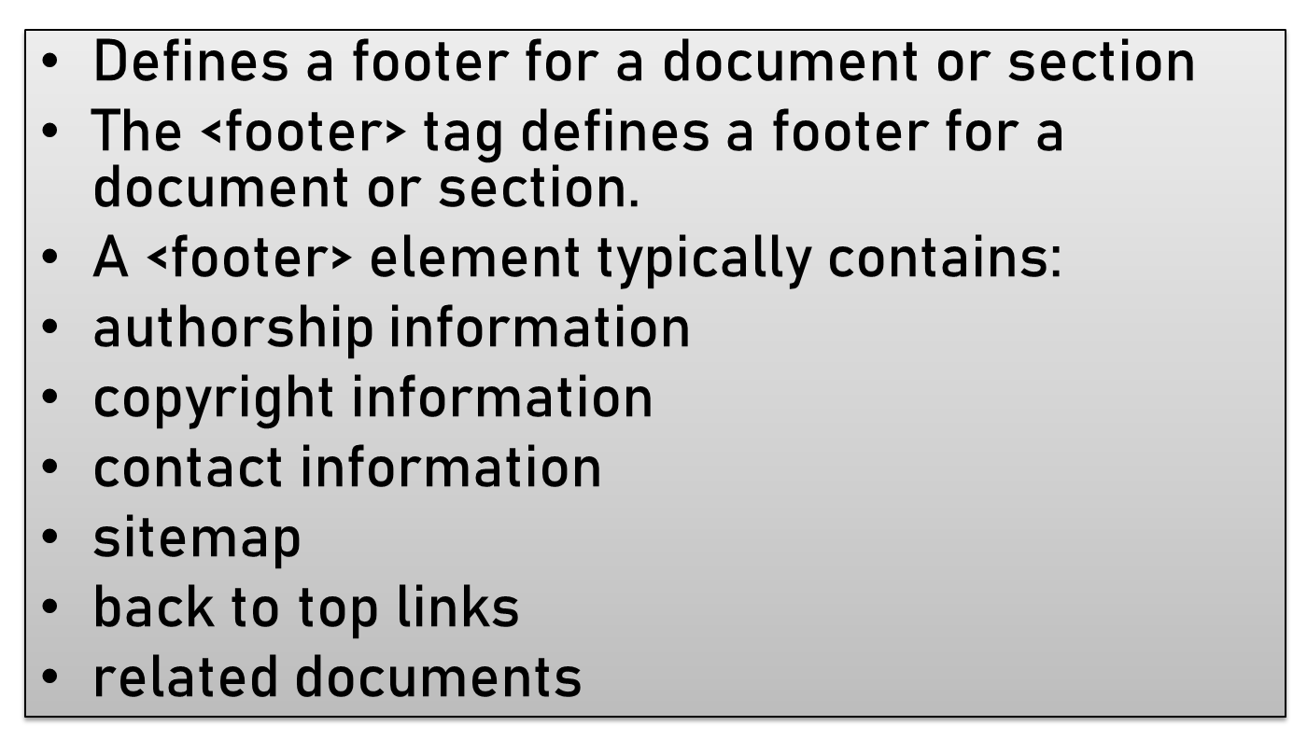
<footer>

Slide 8
<form>
Defines an HTML form for user input
The <form> tag is used to create an HTML form for user input.
The <form> element can contain one or more of the following form elements:
<input>
<textarea>
<button>
<select>
<option>
<optgroup>
<fieldset>
<label>
<output>

Slide 9
<h1> to <h6>
Defines HTML headings
The <h1> to <h6> tags are used to define HTML headings.
<h1> defines the most important heading. <h6> defines the least important heading

Slide 10
<head>
Contains metadata/information for the document
The <head> element is a container for metadata (data about data) and is placed between the <html> tag and the <body> tag.
Metadata is data about the HTML document. Metadata is not displayed.
Metadata typically define the document title, character set, styles, scripts, and other meta information.
The following elements can go inside the <head> element:
<title>(required in every HTML document)
<style>
<base>
<link>
<meta>
<script>
<noscript>

Slide 11
<header>
Defines a header for a document or section
The <header> element represents a container for introductory content or a set of navigational links.
A <header> element typically contains:
one or more heading elements (<h1> - <h6>)
logo or icon
authorship information
It can have several <header> elements in one HTML document. However, <header> cannot be placed within a <footer>, <address> or another <header> element

Slide 12
<hr>
Defines a thematic change in the content
The <hr> tag defines a thematic break in an HTML page (e.g. a shift of topic).
The <hr> element is most often displayed as a horizontal rule that is used to separate content (or define a change) in an HTML page.

Slide 13
<html>
Defines the root of an HTML document
The <html> tag represents the root of an HTML document.
The <html> tag is the container for all other HTML elements (except for the <!DOCTYPE> tag).
It should always include the lang attribute inside the <html> tag, to declare the language of the Web page. This is meant to assist search engines and browsers

Slide 14
<label>
Defines a label for an <input> element
The <label> tag defines a label for several elements:
<input type="checkbox">
<input type="color">
<input type="date">
<input type="datetime-local">
<input type="email">
<input type="file">
<input type="month">
<input type="number“>
<input type="password">
Screen reader users (will read out loud the label, when the user is focused on the element)
Users who have difficulty clicking on very small regions (such as checkboxes) - because when a user clicks the text within the <label> element, it toggles the input (this increases the hit area).

Slide 15
<link>
Defines the relationship between a document and an external resource (most used to link to style sheets)
The <link> tag defines the relationship between the current document and an external resource.
The <link> tag is most often used to link to external style sheets or to add a favicon to your website.
The <link> element is an empty element, it contains attributes only.

Slide 16
<img>
Defines an image
The <img> tag is used to embed an image in an HTML page.
Images are not technically inserted into a web page; images are linked to web pages. The <img> tag creates a holding space for the referenced image.
The <img> tag has two required attributes:
src - Specifies the path to the image
alt - Specifies an alternate text for the image, if the image for some reason cannot be displayed

Slide 17
<input>
Defines an input control
The <input> tag specifies an input field where the user can enter data.
The <input> element is the most important form element.
The <input> element can be displayed in several ways, depending on the type attribute.
The different input types are as follows:
<input type="button">
<input type="checkbox">
<input type="color">
<input type="date">
<input type="datetime-local">
<input type="email">
<input type="file">

Slide 18
<output>
Defines the result of a calculation
The <output> tag is used to represent the result of a calculation (like one performed by a script).

Slide 19
<p>
Defines a paragraph
The <p> tag defines a paragraph.
Browsers automatically add a single blank line before and after each <p> element.
Use CSS to style paragraphs

Slide 20
<picture>
Defines a container for multiple image resources
The <picture> tag gives web developers more flexibility in specifying image resources.
The most common use of the <picture> element will be for art direction in responsive designs. Instead of having one image that is scaled up or down based on the viewport width, multiple images can be designed to more nicely fill the browser viewport.
The <picture> element contains two tags: one or more <source> tags and one <img> tag.
The browser will look for the first <source> element where the media query matches the current viewport width, and then it will display the proper image (specified in the srcset attribute). The <img> element is required as the last child of the <picture> element, as a fallback option if none of the source tags matches

Slide 21
<select>
Defines a drop-down list
The <select> element is used to create a drop-down list.
The <select> element is most often used in a form, to collect user input.
The name attribute is needed to reference the form data after the form is submitted (if you omit the name attribute, no data from the drop-down list will be submitted).
The id attribute is needed to associate the drop-down list with a label.
The <option> tags inside the <select> element define the available options in the drop-down list

Slide 22
<style>
Defines style information for a document
The <style> tag is used to define style information (CSS) for a document.
Inside the <style> element you specify how HTML elements should render in a browser.

Slide 23
<sub>
Defines subscripted text
The <sub> tag defines subscript text. Subscript text appears half a character below the normal line, and is sometimes rendered in a smaller font. Subscript text can be used for chemical formulas, like H₂O.

Slide 24
<sup>
Defines superscripted text
The <sup> tag defines superscript text. Superscript text appears half a character above the normal line, and is sometimes rendered in a smaller font. Superscript text can be used for footnotes, like WWW.

Slide 25
<u>
Defines some text that is unarticulated and styled differently from normal text
The <u> tag represents some text that is unarticulated and styled differently from normal text, such as misspelled words or proper names in Chinese text. The content inside is typically displayed with an underline. You can change this with CSS (see example below).

Slide 26
<video>
Defines embedded video content
The <video> tag is used to embed video content in a document, such as a movie clip or other video streams.
The <video> tag contains one or more <source> tags with different video sources. The browser will choose the first source it supports.
The text between the <video> and </video> tags will only be displayed in browsers that do not support the <video> element.

